Slide 1

About Me
Name : Shinde Deepali R Tipirneni
Qualification : B.Sc. in Information technology
Work Experience : 8 years experience in Health Care and Education Field.

Slide 2

Amcat Exploratory Data analysis

Slide 3
My objective is to determine the salary of an engineering graduate in india

Slide 4
TABLE OF CONTENT
Technologies /Libraries Used
Pandas
NumPy
Matplotlib
Seaborn
Steps Involved:
Importing necessary libraries
Exploring Datasets with pandas
Data Type Conversion
Feature Engineering
Univariate analysis
Bivariate Analysis
Multivariate Analysis
Outlier removal

Slide 5
01
Database overview
The dataset contains the employment outcomes of engineering graduates.
The dataset contains around 40 independent variables and 4000 data points.

Slide 6
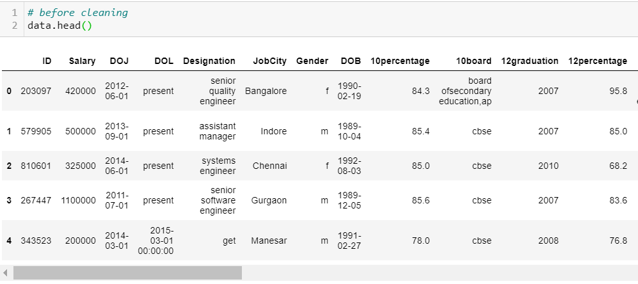
Before cleaning
Total data set contains 40 features and 4000 observations

Slide 7
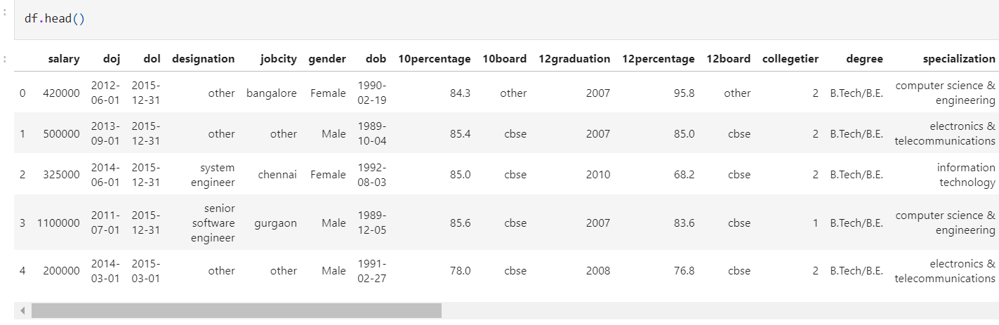
After cleaning
Total data set contains 38 features and 3998 observations

Slide 8
02
Data visualization

Slide 9
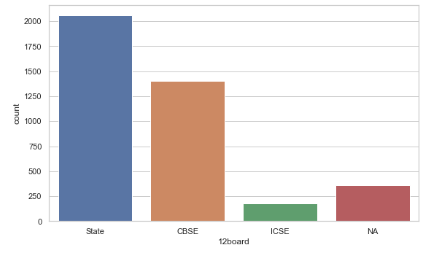
Univariate Analysis
Categorical Feature
Most of the students have completed their intermediate in State Board

Slide 10
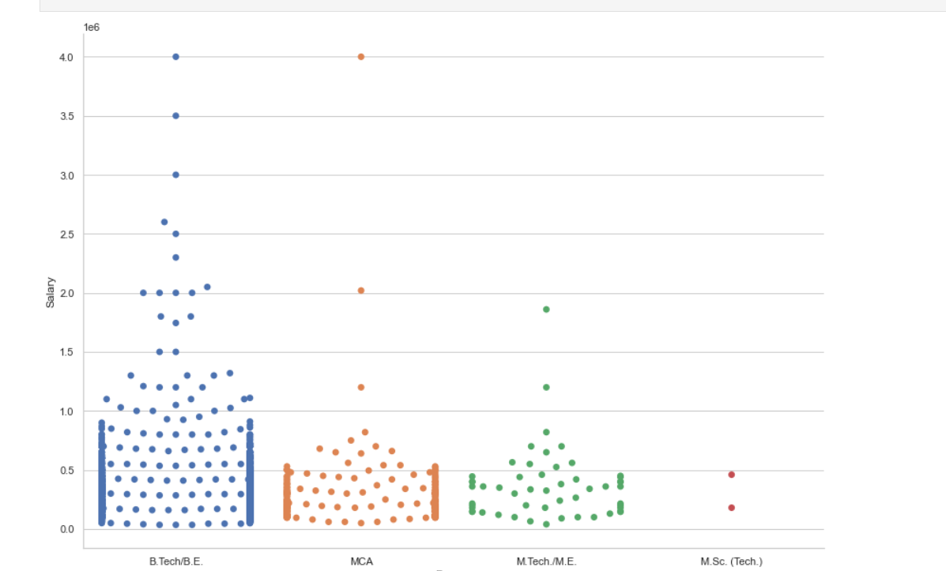
higher chances of placements
Graduated from B.Tech has higher chances of a getting a job with higher salaries

Slide 11
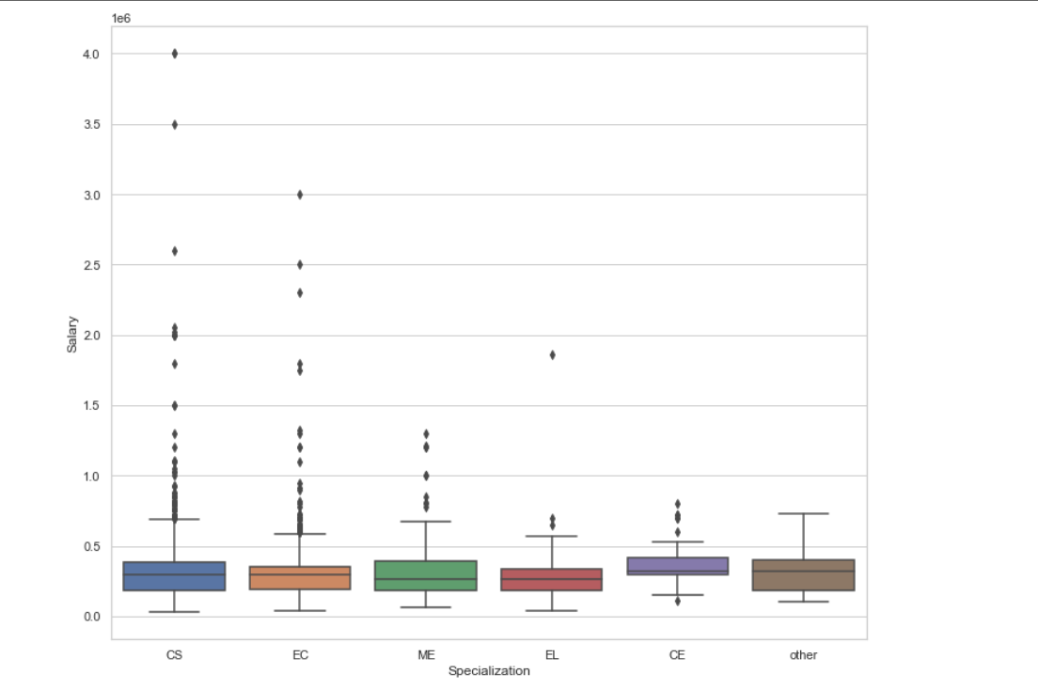
specializations salary
Graduates With Specialization in CS has higher chances to get more salary around 1,80,000 - 4,00,000

Slide 12
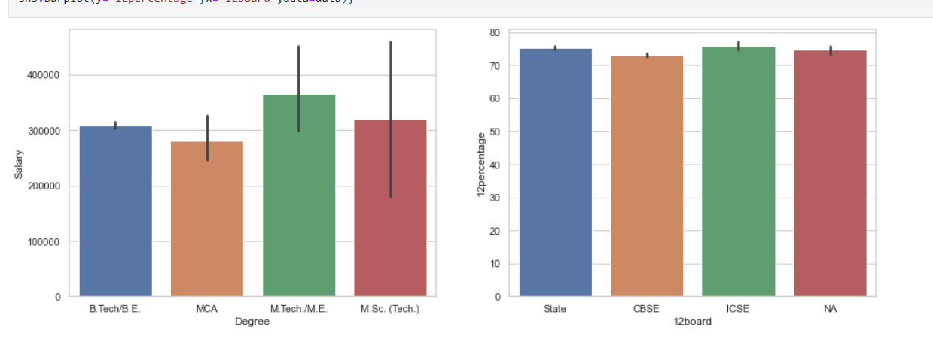
highest salary
board having max %?
Graduates who has done Masters has higher salaries
Students from ICSE has higher percentages
ICSE

Slide 13
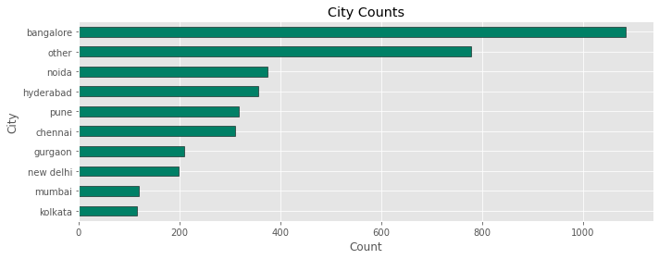
cities highest job placements
The most favorable city for job placements is Bangalore, followed by Noida, Hyderabad and Pune. Mumbai and Kolkata being least favorable.

Slide 14
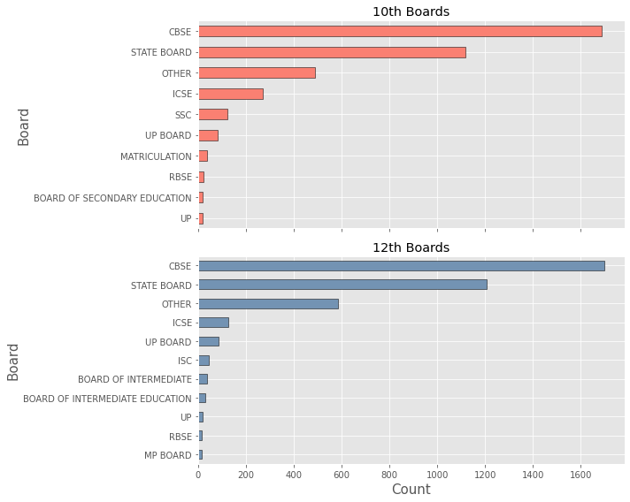
10th – 12th common boards
CBSE is the most common school board for both 12th- 1737 and 10th- 1726.

Slide 15
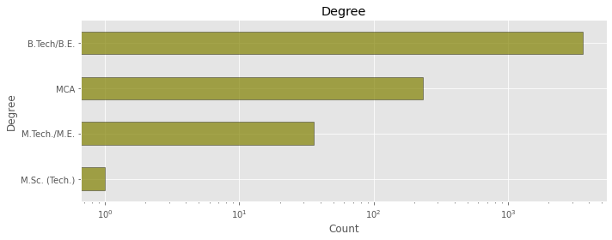
Degree
Most of the students have done their graduation in B.Tech and there are very less students from M.Sc.(Tech)

Slide 16
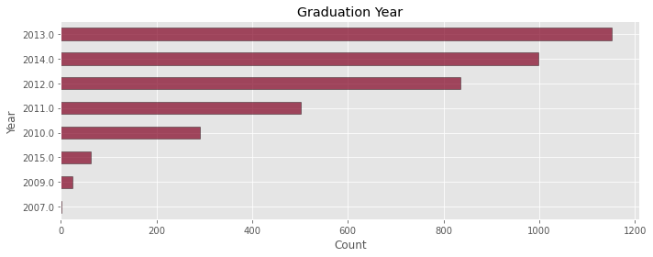
GRADUATION YEAR
Maximum number of students were graduated in 2013, followed by the year 2014 and 2012.

Slide 17
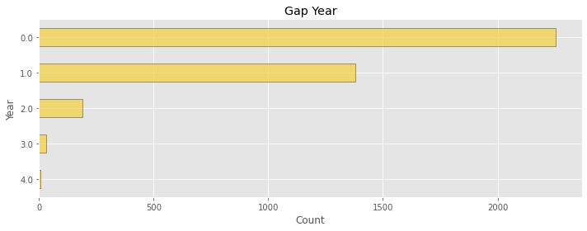
Number of year gap
Maximum number of students have 0 gap years i.e. the students got placed in the same year they got graduated. Some students do have 1 year gap.
75% of student's are less than 26 years old.

Slide 18
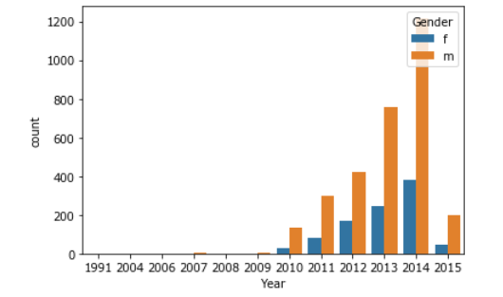
MALE vs female
From this we can directly conclude that the joining of male is greater than females every year.

Slide 19
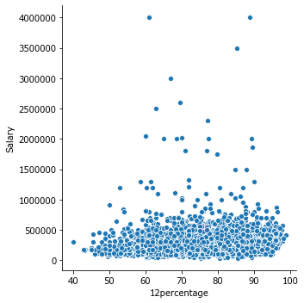
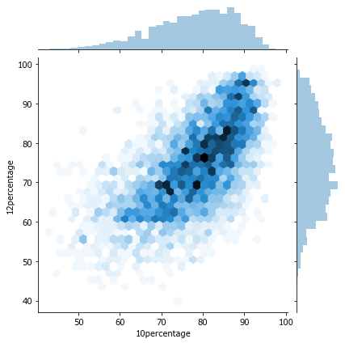
10th & 12th percentage
Almost all candidates gets salary between 0 and 10,00,000 except some outliers which are also the one who scored more than 60% in 12th.
10th percentage = There are very less students with low % and the majority of the students scored b/w 75% - 90%. Maximum number of students scored 78% and on average the score was 77%.
12th percentage = There are very less students with low % and the majority of the students scored b/w 69% - 84%. Maximum number of students scored 70% and on average the score was 74%.

Slide 20
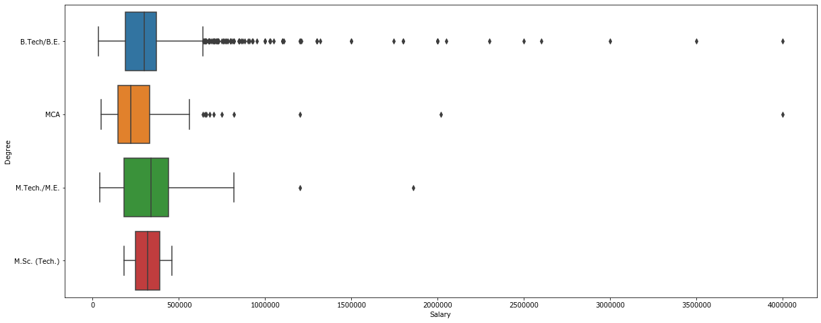
Average salary
B.Tech./B.E. students get the most salary but median says MTech have more average salary.

Slide 21
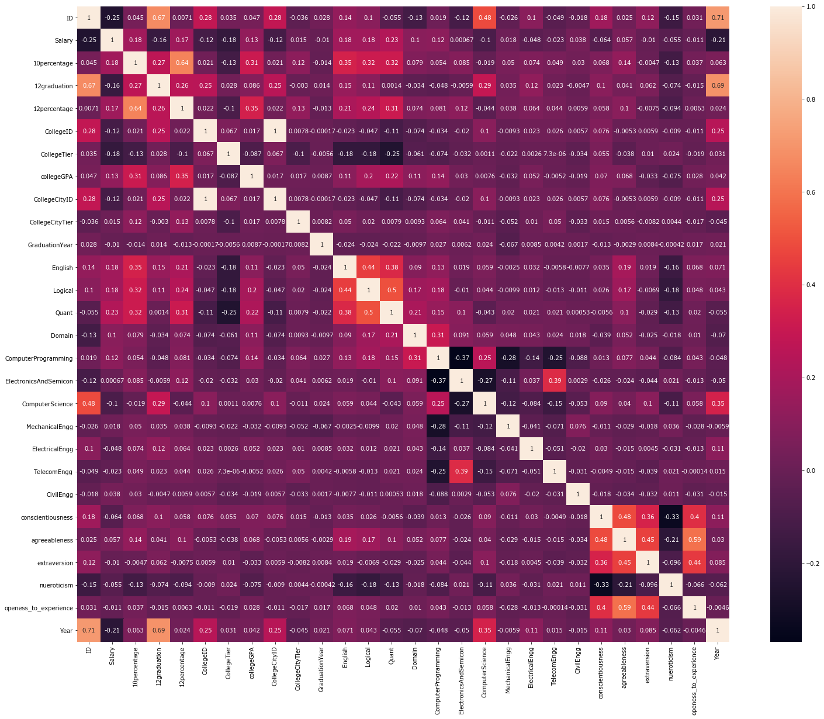
Correlate columns
12thgraduation & Id
10percentage & 12thpercentage
Computer Science & ID
CollegeCityID & CollegeId
Logical & English
Quant & English
Quant & Logical
agreeableness & conscientiousness
agreeableness & extraversion
conscientiousness & openess_to_exp
openess_to_exp & extraversion
openess_to_exp & agreeableness

Slide 22
Question & answers
Q. Which board has completed intermediate?
A. Most of the students have completed their intermediate in State Board around 1140
Q. Which cities has higher chances of placements ?
A. Bangalore , Noida , Hyderabad , & Pune
Q. What is the minimum and maximum of employees?
A. Minimum salary 35000 to max 40,00,00 .
Q. Which cities have highest salary package?
A. Mumbai,Bangalore,Pune and Hyderabad have the highest entry level mean salary while it is surprising to note that cities like Delhi and Kolkata have the lowest entry level salaries for engineering graduates.
Q. In which year large no. of students got graduated?
A. Maximum number of students were graduated in 2013 year 2014 and 2012.
Q. Which college tire is having highest salary?
A. College Tier 1 has higher salary than college Tier 2
Q. Which Tier prefer among following 4 Boards?
A. Students in college tier 2 mostly prefer sate board

Slide 23
03
conclusion
Only ~24% Female candidates perused graduation. We need to motivate more females for graduation

Slide 24

THANK you!
Do you have any questions?
deepalishinde7890@gmail.com
https://www.linkedin.com/in/shinde-deepali-r-tipirneni-25263914b/
https://github.com/Deepali-Shinde

